Slide 1
PaaS Cloud Goat
https://github.com/Coalfire-Research/paas-cloud-goat Rodney Beede

Slide 2



Hands-on Hacking
Self Training
Focused Resource
Exploit the vulnerabilities
Gain experience
Practical instructions
Helpful teaching tips
Consolidated list of
Salesforce app vulnerabilities
Image care of “An image of hands on experience with a wrench and a hammer” Content credentials
Generated with AI ∙ May 10, 2024 at 12:12 PM
Image care of “A hacker trainer” Content credentials
Generated with AI ∙ May 10, 2024 at 12:18 PM
Image care of “A hacker at a one-stop shop for vulnerabilities
Generated with AI ∙ May 10, 2024 at 12:30 PM
Notes:
Black Hat Sound Bytes

Slide 3
Custom Apps in Salesforce
Customer or Partner created
Common Vulnerabilities
Data source injection (SOQL,SOSL)
Authorization
XSS
Authorization Misconfigurations
Notes:
These numbers do not mean one vendor better than another. Just shows vulns do exist.

Slide 4
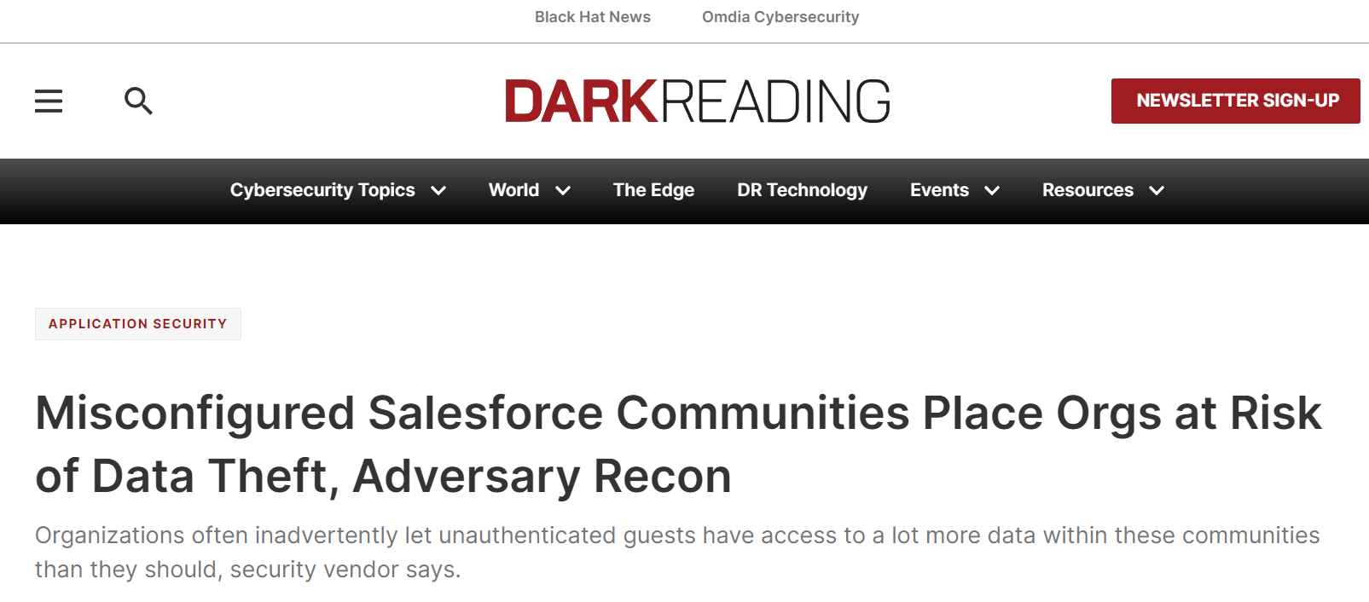
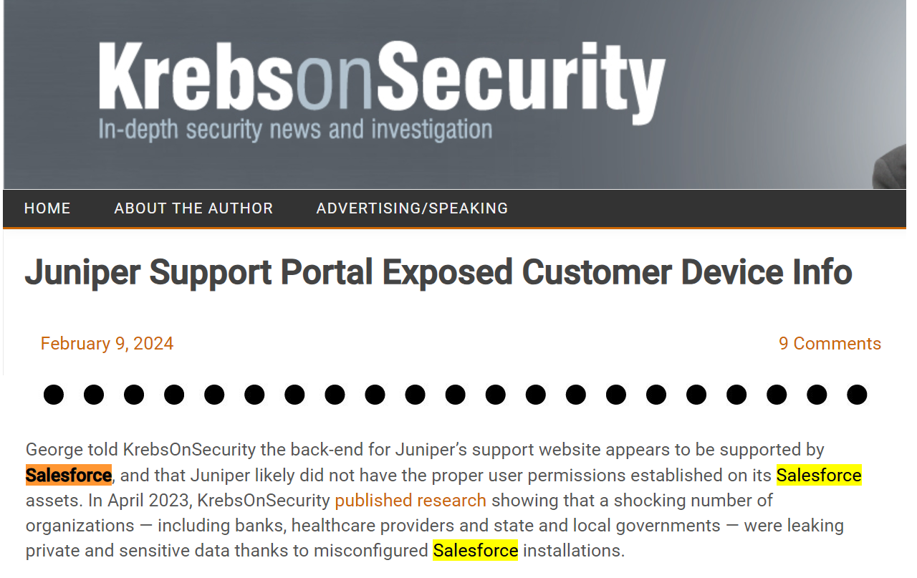
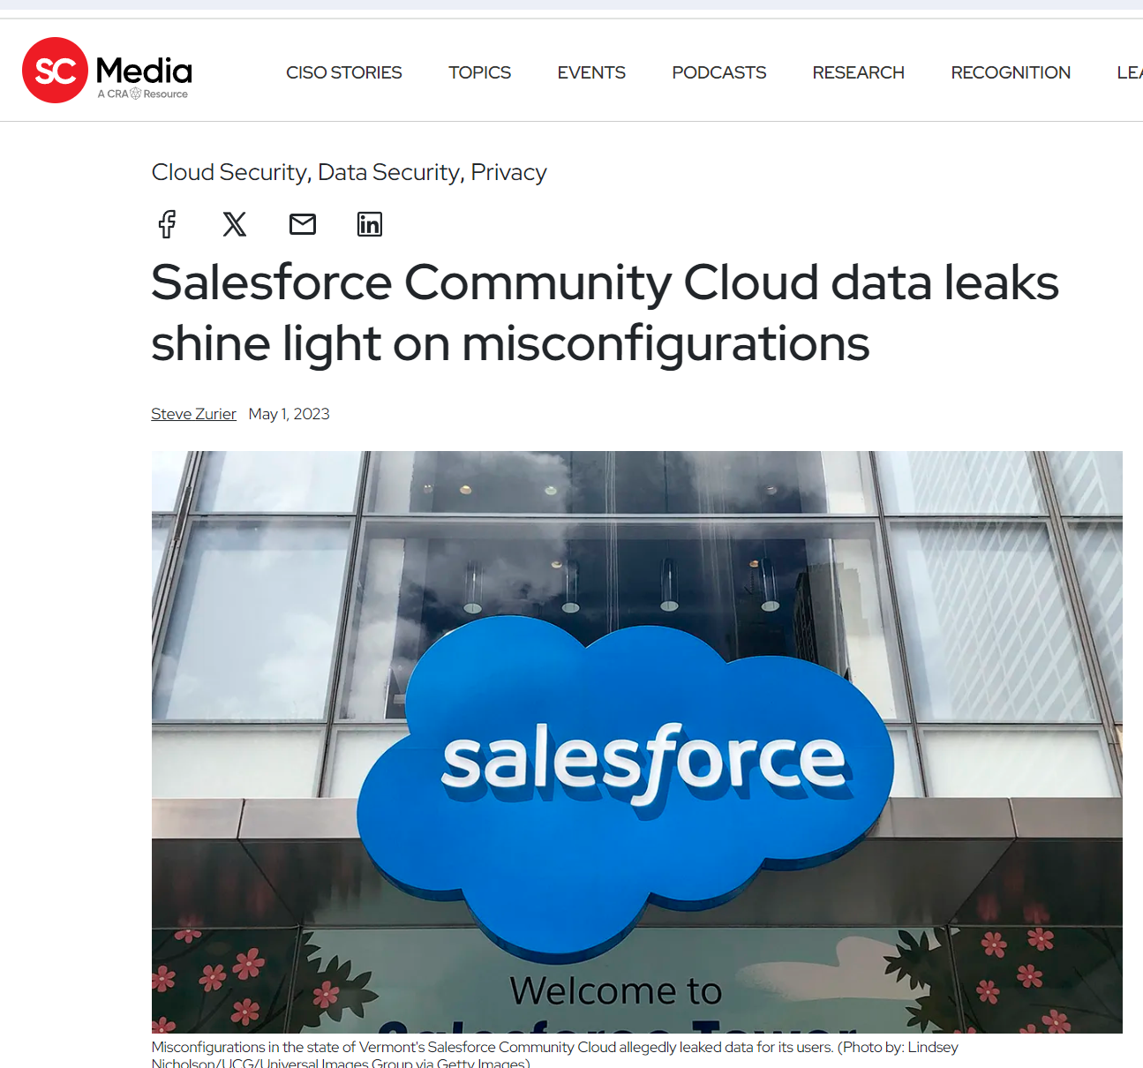
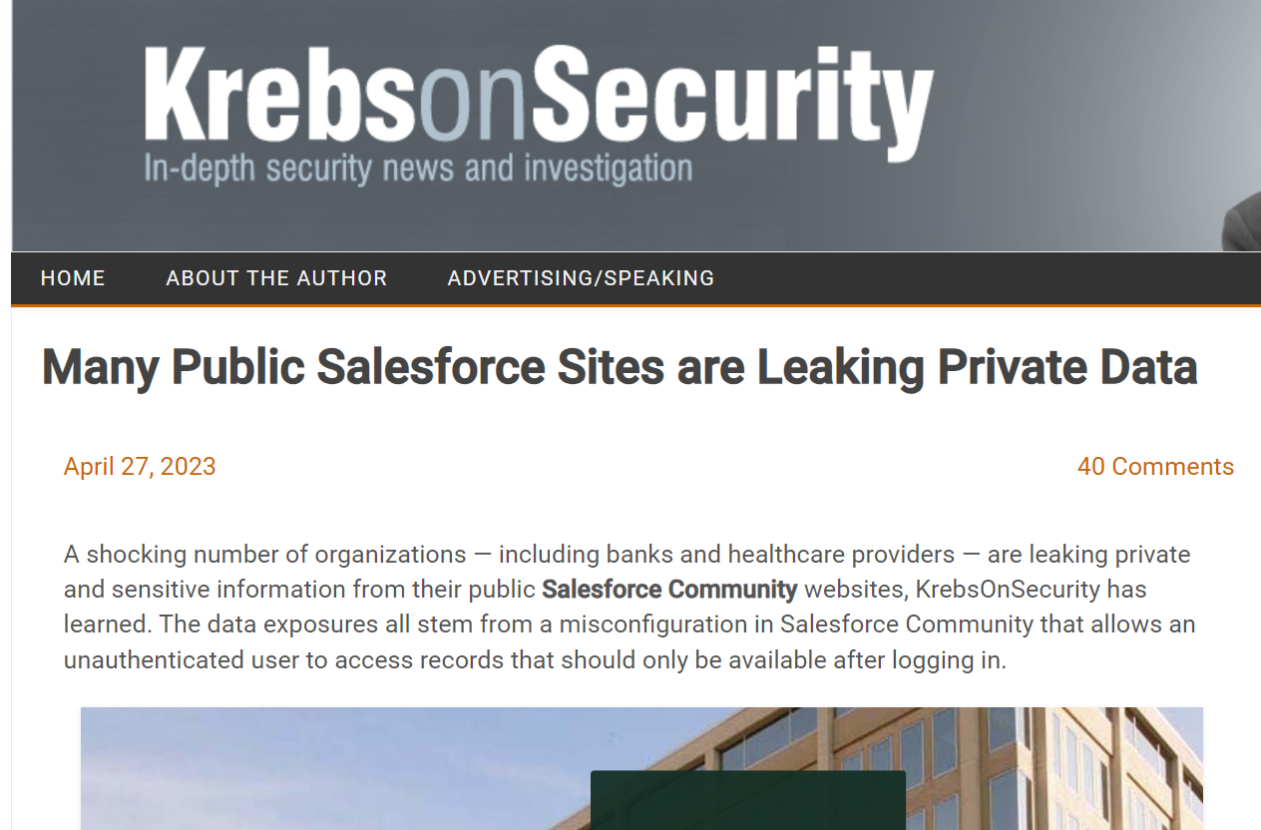
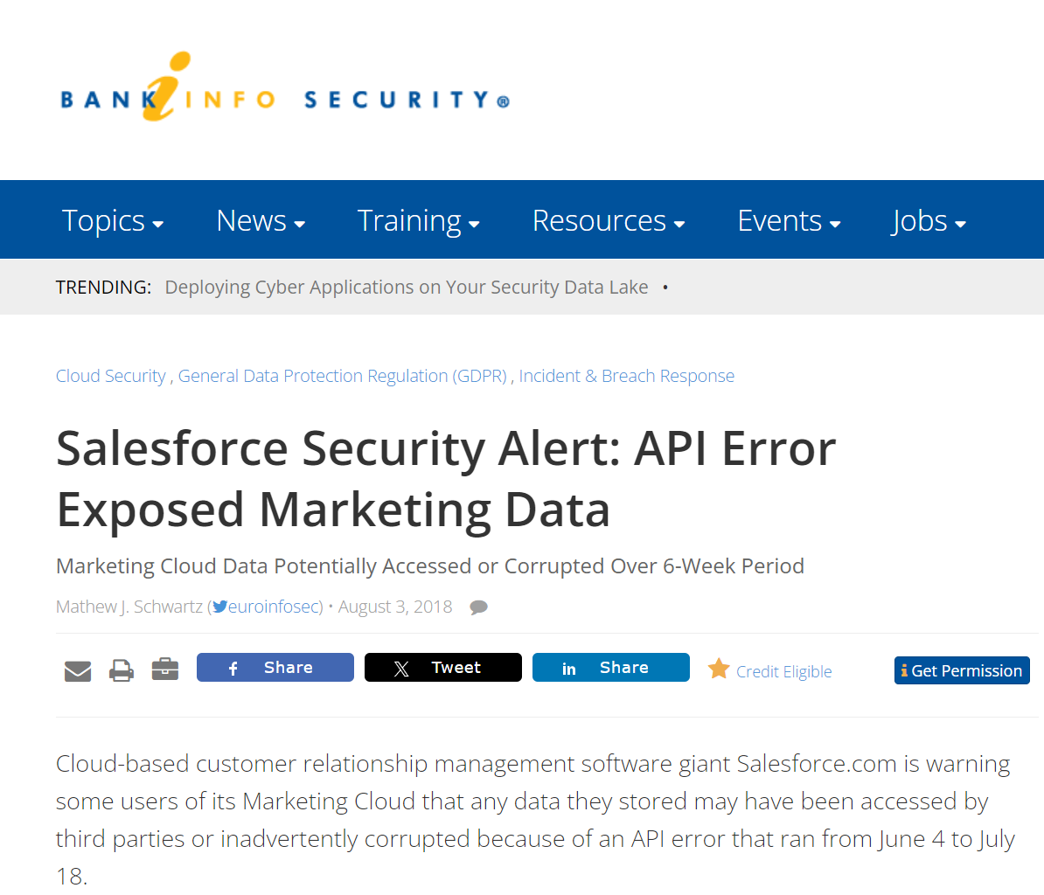
Why Test?
https://krebsonsecurity.com/2024/02/juniper-support-portal-exposed-customer-device-info/
https://www.scmagazine.com/news/salesforce-community-cloud-data-leaks-misconfigurations
https://krebsonsecurity.com/2023/04/many-public-salesforce-sites-are-leaking-private-data/
https://www.bankinfosecurity.com/salesforce-security-alert-api-error-exposed-marketing-data-a-11278
https://www.darkreading.com/application-security/misconfigured-salesforce-communities-place-orgs-at-risk-of-data-theft-adversary-recon

Slide 5
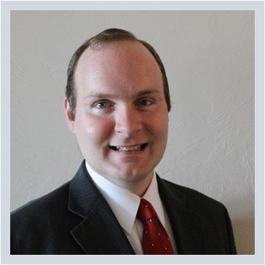
Rodney Beede
Education/certification
M.S. in Computer Science, University of Colorado
CISSP
AWS Security Specialty
OSCP
CSA CCSK
Biography
Rodney is a principal consultant for Coalfire and has specialized in cloud security for over 10 years. He has spoken at multiple conferences on topics from cloud security engineering to IoT device hacking. He has multiple CVEs for discovering web application security vulnerabilities. He started his career in enterprise web application software development but shifted to the security industry with this master's thesis research project "A Framework for Benevolent Computer Worms" 2012. He has held positions at RiskMetrics (MSCI), Cisco, HP, Seagate, Rackspace, and Coalfire.
https://www.rodneybeede.com/curriculum%20vitae/bio.html

